Slide 1
SAP UI5 – Intermediate Level

Slide 2
SAP UI5 – Day 4

Slide 3
UI5I-AC: Advance UI5 Concepts

Slide 4
Agenda :
Navigation and Routing Concepts
Implementing routing in sample application
Control extension
Example of control extension

Slide 5
UI5I-AC-01 : Routing and Navigation in UI5

Slide 6
Navigation & Routing
SAPUI5 uses a hash-based navigation that enables you to pass data from the hash to any view, and to adjust a current hash so that you can use it as a bookmarkable URL. Depending on the hash, you can also generate views automatically. And it enables the app users to use the browser history buttons for navigation.
Navigation is used for the following use cases:
Browser History Handling On mobile devices you do not only have the browser back but also physical back buttons (android).
Bookmarks/Deep Links: bookmark/deep link a page inside an app. This means we can start the app and resume the bookmarked state.

Slide 7
Navigation & Routing
SAPUI5 enable navigation by changing the hash: The browser does not reload the page, instead there is a callback to which the app and especially the affected view can react. Therefore, a string (the hash) is used, which is parsed and matched against patterns which will then inform the handlers. SAPUI5 uses Crossroads.js for parsing the hash and the Hasher framework for manipulating the hash.
The following general rules apply:
The user can always navigate back to the previous page.
Each full page change creates an entry in the back chain (browser history).
The Back button in the upper left corner of an app has always the same functionality as browser back.
All pages can be bookmarked.
Dialogs and popovers can not be bookmarked.

Slide 8
Routing
A route is used to notify your application that the hash has changed to a certain value. When a route matches the hash, it provides the data passed over the hash to a defined handler. The pattern of the route is matched against the hash. If the pattern matches your application will also get the parameters.

Slide 9
Configuration Parameters for Navigation
For navigation, configuration parameters for the route and the router have to be provided.
The router supports the following three parameters:
routes
The routes parameter defines an array of route configurations.
config
The config parameter defines the default values for route configuration.
owner
The owner parameter defines the owner of all views that are created by the router. This is typically a UI Component.

Slide 10
Configuration Parameters for Navigation
For route configuration, SAPUI5 provides the parameters:
Name
The route name parameter identifies the route and has to be unique within one router instance.
Pattern
The pattern parameter defines the string that is matched against the hash. Only the first route with a matching pattern triggers the callback.
View
The view parameter contains the name of the view that is created on the first time a route is matched.
viewType
The view type parameter defines the view type that is created.
viewPath
The view path parameter specifies a prefix that prepends the view

Slide 11
Configuration Parameters for Navigation
targetParent
The target parent parameter defines the ID of the parent of the ‘targetControl’ parameter
targetControl
Views are put into a container control, for example a shell control or a NavContainer for mobile applications, or into any other container.
targetAggregation
The target application parameter contains the name of an aggregation of the target control that contains views.
clearTarget
The clear target parameter defines a boolean that is used to specify if the aggregation should be cleared before adding the view to it.

Slide 12
Configuration Parameters for Navigation
Subroutes
The subroutes parameter contains an array of routes and can contain the complete route configuration. Routes that are added to subroutes may have subroutes themselves.
Callback
The callback parameter is an optional function that is executed after the route has matched.

Slide 13
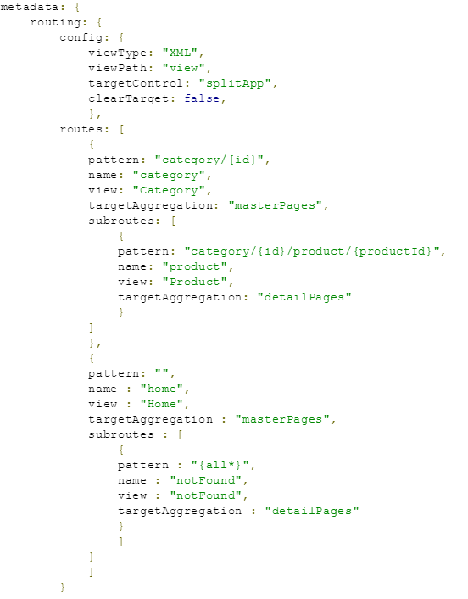
Routing Configuration Syntax

Slide 14
Routing in Component
Configuration
Initialization
Access
View ownership

Slide 15
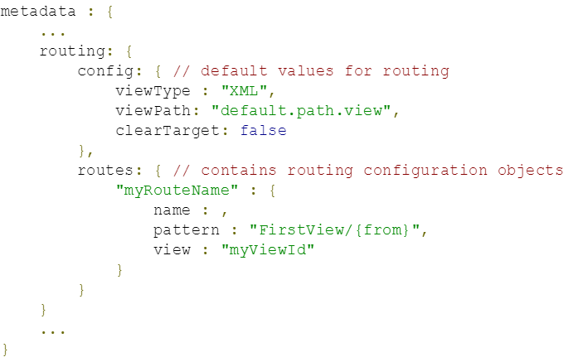
Routing in Component
Configuration
To implement the navigation framework, configure and initialize the router. You can do this inside the component. First, define the routing metadata as follows

Slide 16
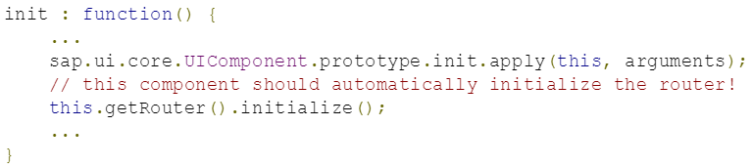
Routing in Component
Initializing
The router now needs to be initialized by the component, for example in the ‘init’ function

Slide 17
Routing in Component
Access
To access the router and to use its functions, use the getRouter() function or the static getRouterFOr function of th UI component.

Slide 18
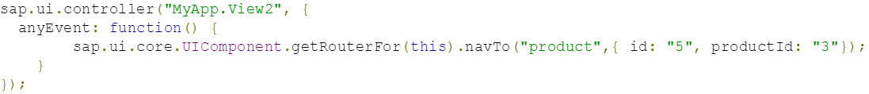
Methods and Events for Navigation
navTo
method to navigate to the given route and fill the hash with the corresponding data. The listener callbacks of controllers listening to this route are provided with data.

Slide 19
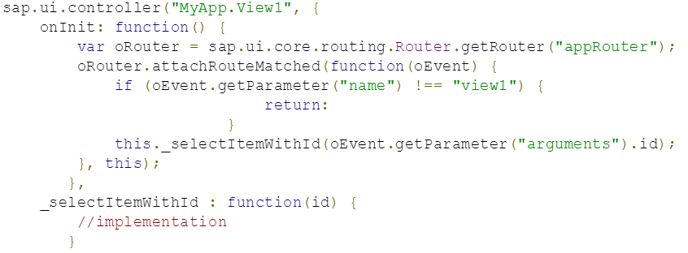
Methods and Events for Navigation
attachRouteMatched
The route matched event is fired every time a changed hash matches a route or a pattern. If you want to only react to specific routes, check if the name parameter matches the route you want to listen to.

Slide 20
Methods and Events for Navigation
attachRoutePatternMatched
This event is similar to route matched, but it only fires for the route that has a matching pattern, and not for its parent route.
viewCreated
This event is fired every time a new view has been created by the navigation system.

Slide 21
Methods and Events for Navigation
attachRoutePatternMatched
This event is similar to route matched, but it only fires for the route that has a matching pattern, and not for its parent route.
viewCreated
This event is fired every time a new view has been created by the navigation system.

Slide 22
UI5I-AC-02 : Control Extensions

Slide 23
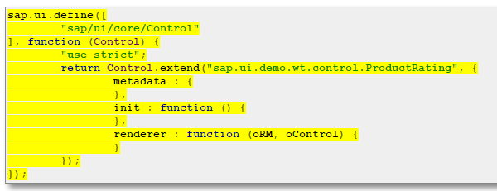

Control extension
Control Extension allows us to create or customize the controls.

Slide 24
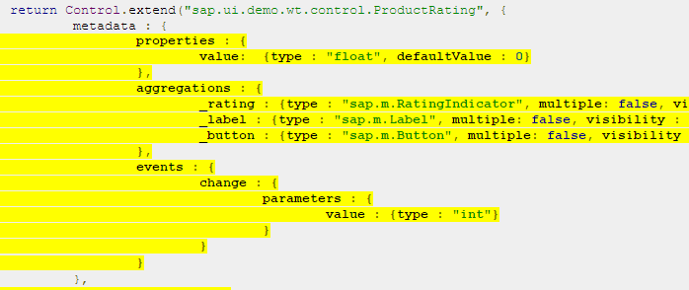
Control extension

Slide 25

Questions???

Slide 26


